Slide 1

Payroll Management System
Inaaya Khan - 44
Aman Singh - 65
Anmol Goyal - 66

Slide 2

Flow of Presentation
Introduction
Problem Statement
Technology Used
Working
Description
Future Scope
Conclusion

Slide 3

Introduction
Payroll Management System is a software made to keep track of employees and their payrolls
Developed using ASP.NET in Visual Studio 2019 , C# Programming Language, XAMPP Server, SQL Database
Developed to make management of employee data simple for companies
It has a user-friendly interface to avoid complications

Slide 4


Problem Statement
To make the existing manual system automatic with the help of computerized equipment and full-fledged computer software, fulfilling their requirements, so that their valuable workforce data and information can be stored efficiently for a longer period with easy access and manipulation of the same

Slide 5

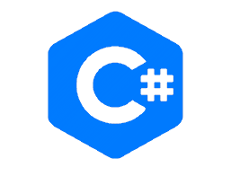


Technology Used
Visual Studio 2019 ASP.NET
C# Programming Language
XAMPP Server
SQL Database

Slide 6



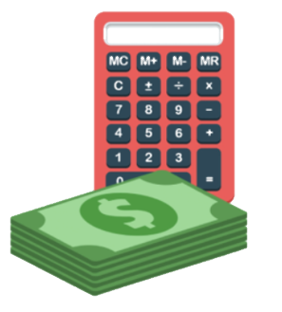
Working
Admin
Can add
Can
Can view
Employees
Payroll
Calculate Paychecks
Separate Departments will have separate databases

Slide 7

Description
This project is built keeping in mind that it is to be used by only one user that is the admin.
It is built for use in small scale organization where the number of employees is limited and handled by a few number of people.
The admin can add new employees in various departments.
The Admin can also calculate predefined pay grades for the employees, with the addition of overtime wage.
The required records can be easily viewed by the admin anytime time he wants in an instant.
The payment of the employee is based on monthly/weekly basis.
Numerous validations implemented would enable the admin to enter accurate data.
The main objective of this framework is to save time, make the system cost effective and manage records efficiently

Slide 8

Future Scope
The option to print the records in future.
Implementation of better and more attractive UI design
We intend to add a leave structure to track paid leaves in the future.
We would like to implement a regular backup mechanism to back up the employee database in case of any mishap.
The system can be developed in such a way that its existing features can be modified to better versions for more efficiency.

Slide 9

Conclusion
We successfully made a project that allows management of employee data and provides better payroll tracking for the admin
It can maintain and view computerized records without storing any redundant entries or overlapping repetitive data.
This System requires less time for processing, reduces paperwork, cost.
The software is easily available and simple to use.
Easily maintains and generates the reports of payroll data
Various details can be provided to the management through reports.
Better management and security.
Less human resources and human effort required, making their job easier.

Slide 10

Thank You

